Slide 1
Calorie Counter App
By: Nitin Chatlani

Slide 2
Purpose
The purpose of the calorie counter app is to help the user meet their weight loss goals
Because so many people make it their new year's resolution to lost weight, this app can help them achieve this goal by showing them their progress and letting them know when they are doing well or when they are going over their daily calorie limit.

Slide 3

Usage
The App In Action:
To launch the app simply click on the app on your phone
The app is pretty self explanatory, you just:
input the information in the specified boxes
Click log food
The app does the rest of the heavy lifting

Slide 4
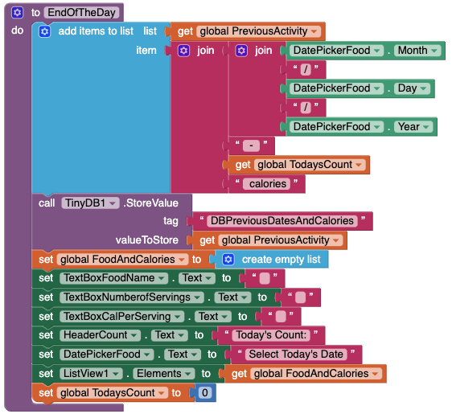
Key Algorithm - EndOfTheDay (pt.1)
Adds the date and the number of calories to the previous days list
Saves the list to the TinyDB variable associated with the list
Sets the daily food and calorie list back to an empty list

Slide 5
Key Algorithm - EndOfTheDay (pt.2)
4. Sets all text boxes for inputs to a blank box
5. Sets the list viewer to the new empty list so the daily food and calories from the previous day can’t be seen in the next day
6. Sets the daily count to 0 since its the next day

Slide 6
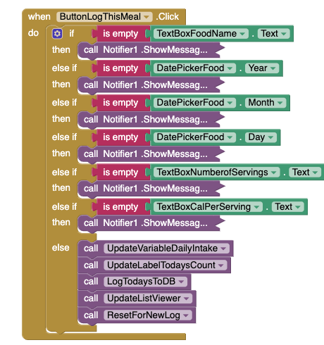
Key Algorithm - ButtonLogThisMeal
The if/then/elseif statements are there to check to see if all of the input requirements are met
For example, in the video in the previous slide, when one of the imputes (i.e. food name, # of calories, etc.) is empty it will call a notifier so the user knows to fill that out.
The else in this triggers 5 more algorithms (next few slides)
Note: this whole button action was going to be a single procedure but I didn’t have enough time which is why I categorized it under algorithms

Slide 7
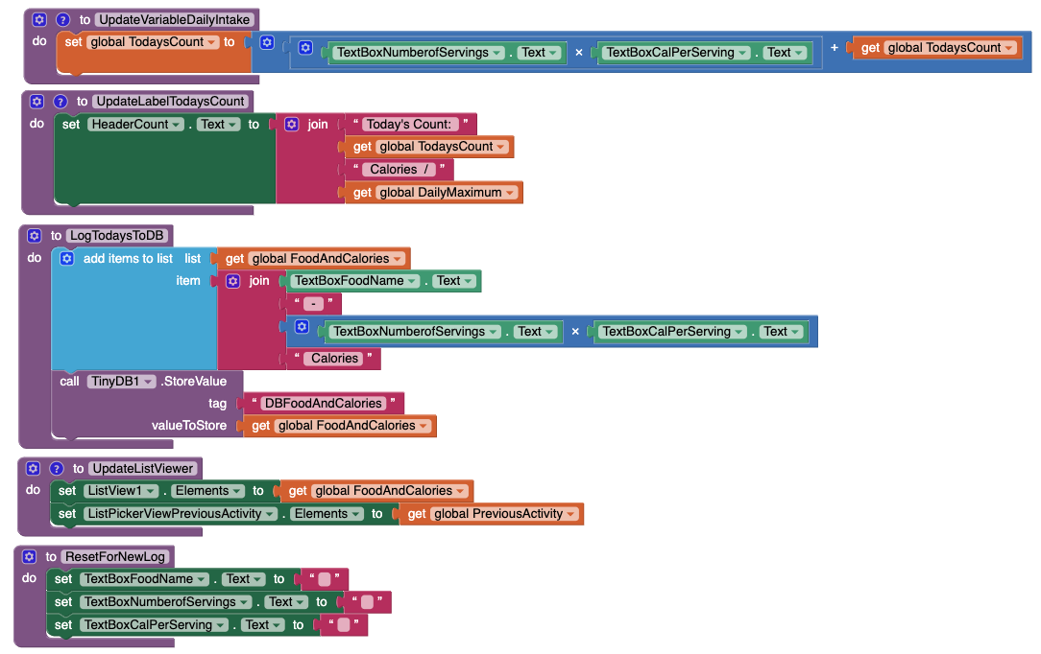
Key Algorithm - UpdateVariableDailyIntake
First it calculates the # of calories in the meal by multiplying the number of servings by the number of calories per serving
Then it adds the total number of calories to the current cal count
Lastly, it sets the variable value to the new number of calories (calculated below)

Slide 8
Key Algorithm - LogTodaysToDB
The goal of this algorithm is to add the daily count of calories and the date to the DB so it is accessible for the rest of the day while you continue logging food.
It does this by first added the text found in the food text box (foodname) and the number of calories in each
It then stores the entire list variable to the TinyDB

Slide 9
Key Algorithm - UpdateListViewer
This procedure sets both of the list elements (the listpicker with the previous days and the listviewer where the user can see the foods they ate that day)
It just uses two set functions to set both the ListViewer and the ListPicker elements to those in the respective list (stored in the variables)

Slide 10
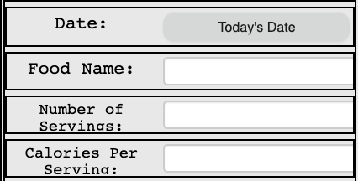
Key Algorithm - ResetForNewLog
This algorithm is the most basic and all it does is set all of the inputs (with the exception of the date so the user doesn’t need to pick it over and over on the same day)
It sets the inputs to blank so that they can change them to
Food Name
Number of Servings
Calories Per Serving

Slide 11
Challenges:
The biggest bug I faced was when the app would close and reopen and then I couldn’t see the previous days
I ended up having to reorder the different commands in the procedure and then it worked as expected
This is important because without this you wouldn’t be able to see your previous progress.

Slide 12
Next Steps
This time around I wasn’t able to fix a bug where the (when closed and reopened) would have the previous days variable overwritten with new info
I would like to fix this and make the app so you can collect unlimited data in the TinyDB without losing it every so often
What will the Calorie Counter App look like in future iterations?
Pt. 1

Slide 13
Next Steps
I would also like to add integrations with fitness tracking apps so that the app could change the DailyMaximum variable to whatever the number of calories burned by the user is.
What will the Calorie Counter App look like in future iterations?
Pt. 2

Slide 14
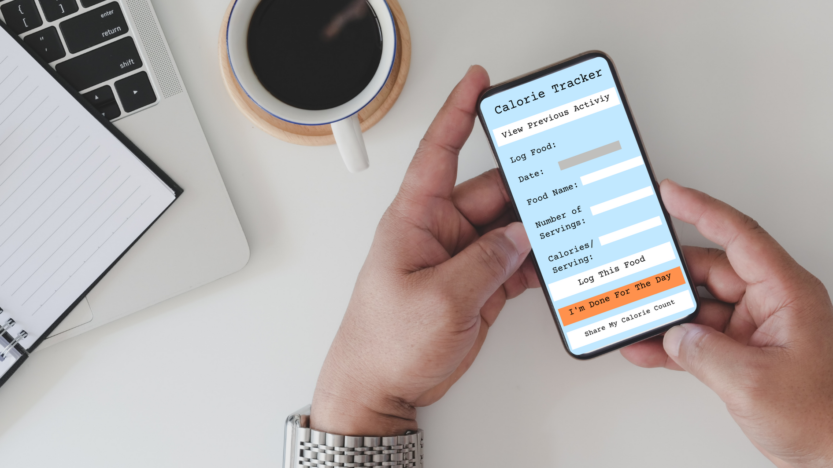
Questions?
Ask away!

